Slide 1

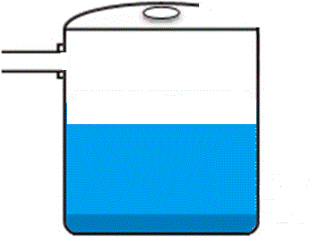
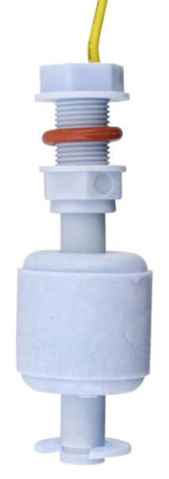
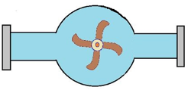
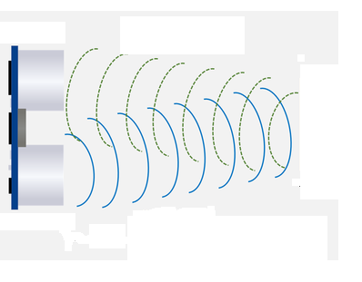

SMS
Water Level=180 cm
SMS
Pump On / Off
Floating
sensor
Ultrasonic sensor
Electric
pump
! Alarm: the tank is full !
Water Tank
Water level

